Slide 1
Hayabusa "peregrine falcon"
Hayabusa is a Windows event log fast forensics timeline generator and threat hunting tool created by the Yamato Security group.
It is written in Rust and supports multi-threading in order to be as fast as possible. We have provided a tool to convert Sigma rules into Hayabusa rule format.

Slide 2
Analysis
Hayabusa can be run either on single running systems for live analysis, by gathering logs from single or multiple systems for offline analysis, or by running the Hayabusa artifact with Velociraptor for enterprise-wide threat hunting and incident response.
The output will be consolidated into a single CSV timeline for easy analysis in Excel, Timeline Explorer, or Elastic Stack.

Slide 3
Threat Hunting and Enterprise-wide DFIR
Hayabusa currently has over 2400 Sigma rules and over 130 Hayabusa built-in detection rules with more rules being added regularly. It can be used for enterprise-wide proactive threat hunting as well as DFIR (Digital Forensics and Incident Response) for free
Fast Forensics Timeline Generation
Windows event log analysis has traditionally been a very long and tedious process because Windows event logs are
1) in a data format that is hard to analyze and 2) the majority of data is noise and not useful for investigations.
Hayabusa's goal is to extract out only useful data and present it in a concise as possible easy-to-read format that is usable not only by professionally trained analysts but any Windows system administrator.
Hayabusa hopes to let analysts get 80% of their work done in 20% of the time when compared to traditional Windows event log analysis.

Slide 4
Extract logs with EDR
EDR SYSTEM go to -> C:\Windows\System32\winevt\Logs

Slide 5
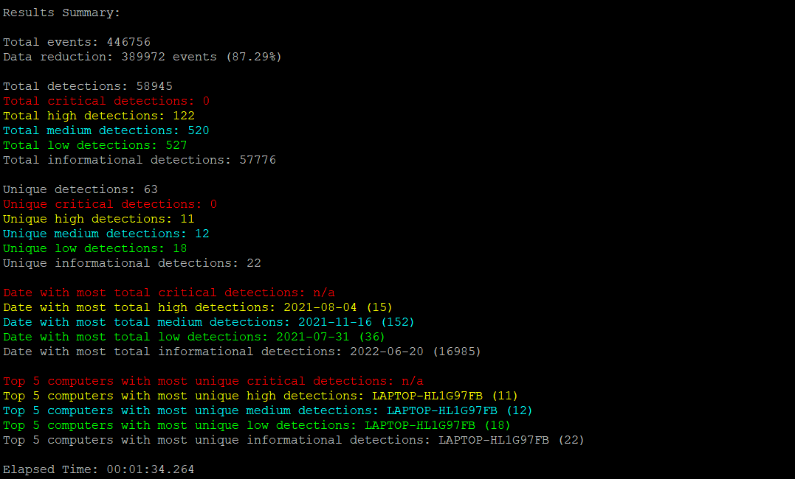
Tool running ./hayabusa-1.3.2-lin-x64-gnu -d /home/Logs/ -v -o result.csv

Slide 6
Tool info
https://github.com/Yamato-Security/hayabusa/releases
Export to a single CSV file for further analysis with excel, timeline explorer, elastic stack, etc... and include all field information:
hayabusa-1.3.2-win-x64.exe -d .\hayabusa-sample-evtx -o results.csv -F

Slide 7
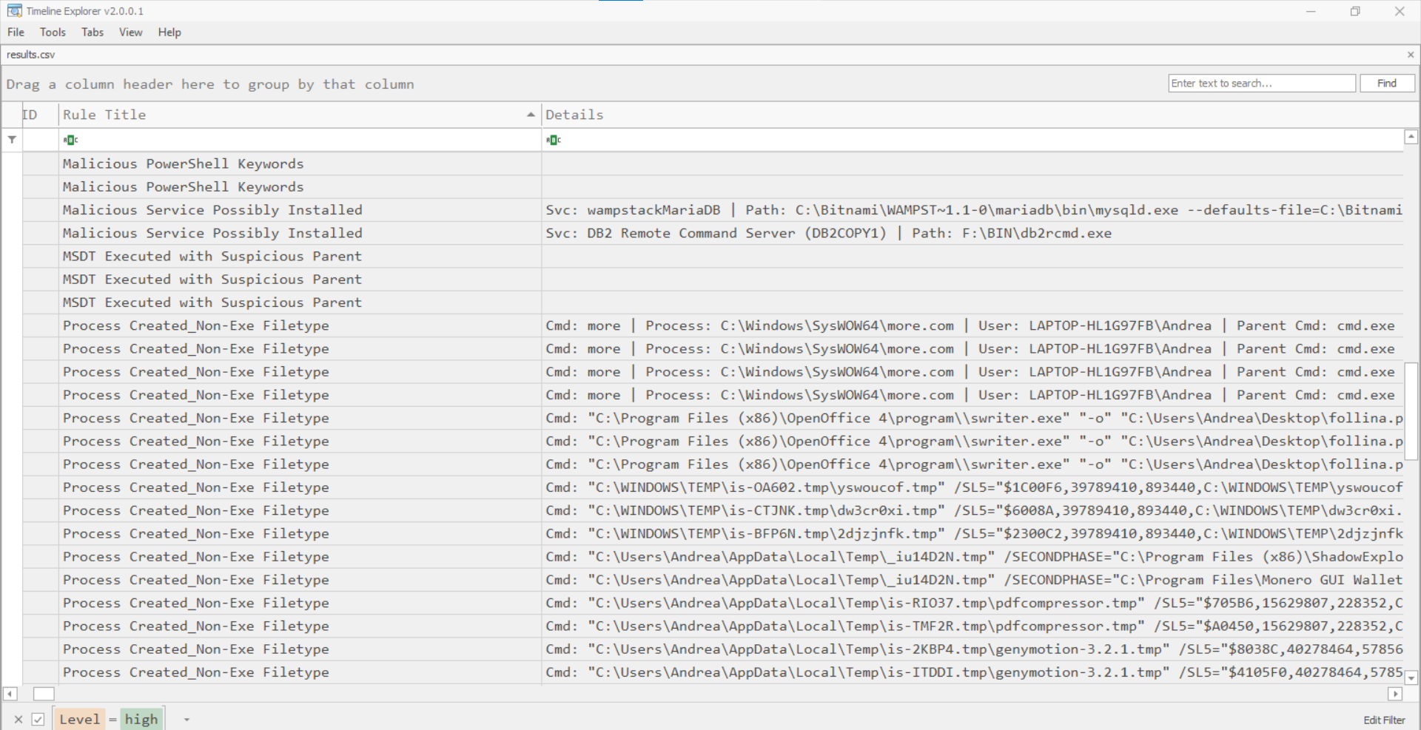
Timexplorer

Slide 8
Detection Rule Tuning
Like firewalls and IDSes, any signature-based tool will require some tuning to fit your environment so you may need to permanently or temporarily exclude certain rules.
You can add a rule ID (Example: 4fe151c2-ecf9-4fae-95ae-b88ec9c2fca6) to rules/config/exclude_rules.txt in order to ignore any rule that you do not need or cannot be used.
You can also add a rule ID to rules/config/noisy_rules.txt in order to ignore the rule by default but still be able to use the rule with the -n or --enable-noisy-rules option.
Detection Level Tuning
You can tune the risk level of the rules by adding them to ./rules/config/level_tuning.txt and executing hayabusa-1.3.2-win-x64.exe --level-tuning which will update the level line in the rule file. Please note that the rule file will be updated directly.
./rules/config/level_tuning.txt sample line:

Slide 9
Event ID Filtering
You can filter on event IDs by placing event ID numbers in config/target_eventids.txt.
This will increase performance so it is recommended if you only need to search for certain IDs.
We have provided a sample ID filter list at config/target_eventids_sample.txt created from the EventID fields in all of the rules as well as IDs seen in actual results.
Please use this list if you want the best performance but be aware that there is a slight possibility for missing events (false negatives).

Slide 10
Import into ELK
https://github.com/Yamato-Security/hayabusa/blob/main/doc/ElasticStackImport/ElasticStackImport-English.md

